Slide 1
Are You the One?
Block Diagram
Tyler Hinrichs

Slide 2
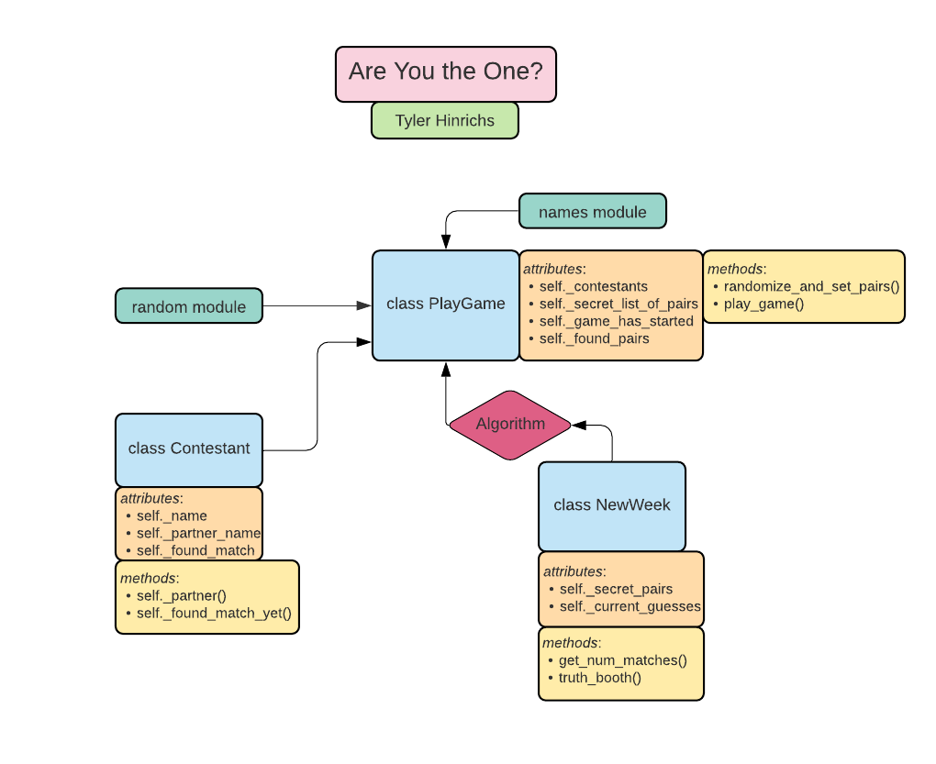

Slide 3
class Contestant:
Initialized with a name
Attributes:
self._name = name
self._partner_name = None
self._found_match = False
Methods:
set_partner(self, name) → sets self._partner_name to value of ‘name’ passed to this function
found_match_yet(self) → returns self._found_match (boolean value)

Slide 4
class PlayGame:
Initialized with: contestant_names = None (default)
Attributes:
self._contestants → list of contestant objects
If contestant_names is None, use names.get_full_name() to generate a list of 16 names
self._secret_list_of_pairs = []
self._game_has_started = False
self._found_pairs = []
Methods:
randomize_and_set_pairs(self) → calls random.shuffle to randomize self._contestants → for i in range(0, 16, 2), append self._secret_list_of_pairs with a nested list comprised of [i, i+1]
play_game(self) → creates an instance of NewWeek()
Method runs recursively until len(self._found_pairs) == 8
Utilizes the chosen algorithm to most efficiently sift through previously tested matches

Slide 5
class NewWeek:
Initialized with: secret_pairs, current_guesses
Attributes:
self._secret_pairs
self._current_guesses
Methods:
get_num_matches(self) → return the number of current guesses that are also in secret pairs
truth_booth(self, pair) → tests whether the given pair passed to the method is in the list of secret pairs, returns boolean value

Slide 6
Potential Additions
I considered creating a TruthBooth class, but it felt redundant so I removed it from the preliminary plan and kept it as a function of NewWeek
I considered creating a separate function (or separate class entirely) to deal with creating new lists of pairs (which I currently have as a list of nested lists); as of now, I have not deemed this necessary

Slide 7
GUI
Degree of Interactivity
Give user the option of entering names
Give user the option of making the decision for the matches each week
Give the option of full randomness in names/chosen perfect match, allow for a fully automated completion of the game
Potential GUI modules to use
PyQt5
TKinter

